Slide 1

Adapting to a changing world
Year 4 report
October 2023 – October 2024

Slide 2
Empower
Sustain
Create
Our strategy has been built on three key themes: Create, Empower and Sustain.
As we reach the end of year 4 of our strategy we are able to reflect on many of our successes despite the impact of the pandemic and its restrictions, staff sickness and recruitment difficulties. With the support of a dedicated and loyal workforce of staff, volunteers and supporters we have accomplished a huge amount of our strategic objectives. Due to the challenges we have faced since the launch in 2020, we decided to extend this current strategy for a 4th year.
We are proud to share our successes as well as the areas where we didn’t manage to achieve our aims. These have informed our next strategic plan ‘The Strength Behind our Stories’.
As we move into launch of our new strategic plan we aim to embed much of the excellent innovations we have introduced while exploring the needs of our community, empowering our team for the future and creating a sustainable business model to ensure the long term success of the Hospice.

Slide 3

www.stcolumbashospice.org.uk

Slide 4
Creating a tiered and flexible model of care which shifts the balance from hospice building based to community focused care
Over the period of this strategy we have successfully:
Increased the number of people we support across all clinical services to over 1,500 every year
Shifted the balance of care by reviewing our inpatient bed complement and transitioning to a new model of care in peoples own homes which includes a multiprofessional specialist team, a ‘hands on’ care at home team and a virtual ward. Collectively this Hospice at Home’ model enables us to have the diverse skills and experience required to successfully care for the diverse need of people living and dying of palliative illness in their homes and has resulted in an 180% increase in the number of people we support to receive their end of life care in their own homes.
Successfully extended our care at home service from Edinburgh into East Lothian and transitioned them to Care Inspectorate regulation and the team to Scottish Social Services Council (SSSC) membership.
Introduced the local NHS electronic patient record system for our patient records enabling real time sharing records across Lothian improving communication, safety and patient experience.
www.stcolumbashospice.org.uk

Slide 5
Creating a tiered and flexible model of care which shifts the balance from hospice building based to community focused care
We have successfully:
Designed, piloted and implemented a new Wellbeing service based in our bespoke Wellbeing Studio, Arts Room and Therapy Rooms which now supports well over 500 people every year.
Worked in partnership with local organisations to deliver our wellbeing services in new settings such as Bellfield community owned building and local libraries in East Lothian.
Continued to provide safe, responsive and person centred clinical services despite pandemic restrictions, capacity challenges and recruitment gaps.
Supported the extreme pandemic pressures that were being faced by our ourselves and our NHS acute colleagues by increasing our Hospice at Home and Counselling capacity
Implemented ‘Resolve’ outcome measures to support triage decisions, patient assessment and service developments.

Slide 6
Creating a tiered and flexible model of care which shifts the balance from hospice building based to community focused care
We have:
Further integrated hospice care in East Lothian through joint working with colleagues in the complex care ward at East Lothian community hospital and integrating referrals management for the Care at home team with local health and social care services.
Our care at home team now support around 300 people every year with well over 5000 visits to provide support in their own homes
Enabled prompt admission to and timely discharge from our inpatient unit from hospital and from patients homes via our new patient transport vehicle.
Our community artist provided creative workshops on loss, change and wellbeing with the Cyrenians at the Newhaven Hub, as well as ELGT (Edinburgh & Lothians Greenspace Trust) workshops that have supported homeless people working with Access Place, mental health patients from Cambridge House at the Hermitage and a forensic group at the Royal Edinburgh Hospital. We also contributed with a creative workshop to this year’s Demystifying Death week in collaboration with the Compassionate Neighbours team.

Slide 7
Creating a tiered and flexible model of care which shifts the balance from hospice building based to community focused care
We have:
Participated in numerous arts festival and community events, such as the Healing Arts Festival, and Leith Festival.
Contributed to national weeks, such as To Absent Friends, with creative community engagement activities to create opportunities for the public to engage with loss and change
Organised our first photography competition which led to the development of our 2024 hospice calendar, and a related photography exhibition.
Established a partnership with St Mary’s Music School to promote musical care and community engagement opportunities for their students.
Established a regular live music programme at Iona Café, in collaboration with musicians from the local community

Slide 8
Creating a tiered and flexible model of care which shifts the balance from hospice building based to community focused care
Over the period of this strategy we did not complete the following commitments:
Capacity issues meant we were unable to complete the plan to extend our pharmacist role in non medical prescribing.
We piloted 5 short stay inpatient beds as part of our Wellbeing service however this innovative idea proved not to be a sustainable, cost effective long term option however our learning continues to be applied as we prioritise positive risk taking, person centred goal setting and palliative rehabilitation across our clinical services.
Next Steps:
We successfully improved the experience for people needing timely access to medications in their own home through partnership working with the palliative care network pharmacies, however we would like to further strengthen this area by implementing community based prescribing and will work in partnership with our colleagues at Marie Curie Hospice to consider additional future, Lothian wide opportunities.
We will continue to engage with our East Lothian colleagues to ensure we are partners and can have influence and impact as part of their upcoming palliative care strategy review.
We will continue to review all our policies and publications to ensure they are assessed against equality and diversity aspects.

Slide 9
Creating new knowledge and innovative ways of working to influence the wider provision of palliative and hospice care
Over the period of this strategy we have successfully:
Offered placements for art therapy, occupational therapy, physiotherapy, nursing and medical students.
Contributed to the supervision of dissertations for undergraduates, master's students and PhD candidates. We also teach the palliative care component of the undergraduate programme for radiographers.
Supported two medical research fellows to be awarded their MD
Established an ECHO Network to support the development of palliative care for homeless people in partnership with Milestone House, creating a space for collaborative learning and sharing of experiences of supporting people experiencing homelessness.
Collaborated with colleagues from the Prince and Princess of Wales Hospice, Glasgow Psychological Services and Child Bereavement UK to create a poster for the NES Bereavement Conference and received a ‘Highly Recommended’ award for this joint working.
www.stcolumbashospice.org.uk

Slide 10
Creating new knowledge and innovative ways of working to influence the wider provision of palliative and hospice care
We have successfully:
Launched a ‘resilience based clinical supervision’ project, with impact extended through train the trainer program for staff across all departments of the Hospice
Implemented medical staff rotation between inpatient and community care, ensuring attractive GP placements for GP trainees, who will take their skills back into primary care.
Been recognised as the first University Hospice in the east of Scotland in March 2022, formally recognising the quality of research and teaching carried out at the Hospice
Worked in partnership with our colleagues in Hospital based community clinical care to create guiding principles for seamless transfer of patients between care settings
Continued to host local, national and international visitors to share our learning and experiences and to learn from them.

Slide 11
Creating new knowledge and innovative ways of working to influence the wider provision of palliative and hospice care
We have successfully:
Shared our Virtual Ward, Care at Home, Wellbeing Service and Bereavement friendly schools learning with colleagues across other hospices and palliative care settings nationally to encourage similar developments elsewhere.
Won the 2023 ‘Building better Healthcare’ patients choice award for our intergenerational songwriting work for change, loss
and grief.
Been finalists in the 2023 ‘Building better Healthcare’ awards for ‘Best Arts Performance Collaborative Projects in the UK’.
Appointed a new Director of Education, Research and Creative Arts to demonstrate our commitment to creating new knowledge and to enhance our positioning as a research hospice with innovation and creativity at its heart.
Received the Demystifying Death award from good life, good death, good grief for our schools work in the category of ‘Creative innovation’.

Slide 12
Creating new knowledge and innovative ways of working to influence the wider provision of palliative and hospice care
We have successfully:
Worked in partnership with QMU to create innovation incubators as part of the teaching programme for undergraduate and postgraduate physiotherapy and occupational therapy students.
Developed a toolkit for our teams to encourage and support the creation of high quality conference poster presentations.
Created a bespoke clinical skills laboratory in our Wellbeing unit utilising technology to enhance training and support for our team staff with technical skills.
Collaborated with the bereavement charter working group from good life, good death, good grief to hold ‘care to action’ events to drive forward the recommendation made to the Scottish Government from the Bereavement Summit report.
Participated in a UK wide practice development project with St Christophers Hospice, London and Queen Margaret University.

Slide 13
Creating new knowledge and innovative ways of working to influence the wider provision of palliative and hospice care
We have
Celebrated our hospice consultant becoming Professor following being awarded a personal chair in palliative medicine at the University of Edinburgh.
Supported our hospice lecturer to commence her PHD through Queen Margaret University on a research study aiming ‘to understand how the changing landscape of palliative care has influenced the role and person centered approach of hospice clinicians’.
Conducted internal and external education and research consultations to identify current resources, needs and priorities, as well as future priorities for education and research.
Inaugurated and piloted an arts therapies interns knowledge exchange group with Mount Sinai Hospital and the Kravis Centre in New York, with a focus on palliative care. This peer group met once per month and following positive feedback the group will resume October 2024 – March 2025.
Delivered new fortnightly education sessions with our colleagues at Marie Curie, initially aimed at doctors new to palliative care, but expanding to include complex care medical staff and nurse specialists.

Slide 14
Creating an environment of community engagement, support and partnership
We have successfully:
Established a Compassionate Communities team who cultivate and develop relationships with community groups across Lothian, helping to reshape attitudes and behaviours towards deteriorating health, dying and bereavement. We are currently working with 3 community groups and have circa 50 volunteer compassionate neighbours engaged with our patients and families in their own homes
Worked collaboratively with Scottish Hospices and Public Health Scotland to generate Hospice specific pandemic guidance.
Launched the St Columba's Hospice Care Palliative Care Award: One award was given to a QMU nursing student at the celebration event for the nursing division on 6th May. A further Palliative care Award was awarded to a medical student at University of Edinburgh
Launched a refreshed patient and family feedback system using QR codes to improve accessibility.
www.stcolumbashospice.org.uk

Slide 15
Creating an environment of community engagement, support and partnership
We have:
Restructured our Community and Events fundraising team to better deliver activity and development across the important areas.
Developed new corporate links including a highly successful Charity of the Year partnership.
Following the success of East Lothian and Edinburgh dinner events we have Employed a new High Profile Events Manager to lead, grow and develop these events.
Seen strong growth across our shop units, including in our new Stockbridge shop.
Continued to recruit new lottery players and now have well over 2,000 new numbers added to our draw.
Started a Regular Giving push, initially delivered through our Summer Appeal 2024 and now also promoted by our lottery canvassers alongside the lottery.
Opened a new Hair and Nail Studio, Studio15, on the site of Hospice Gatehouse. This expands our income generation possibilities and offering.

Slide 16
Creating an environment of community engagement, support and partnership
Next steps:
We have identified and secured a lease for a new Furniture Shop and Warehouse unit in a central Edinburgh location. We hope to open in early 2025.
We have purchased a new property in North Berwick which will be a second hand bookshop, café and art space and is set to open in early 2025.
We have been part of process regarding the newly approved Scottish Hospices Together Corporate Development Lead post. To be recruited in 2025
We will further extend our relationships with community partners through creative arts projects for a public health and community engagement prospective.
We will develop our second year of a series of public palliative care arts talks.

Slide 17
Creating new ways to share our message, aims and objectives with our community, and new ways to engage with our supporters and donors
Over the period of this strategy we have successfully
Further developed our ‘quality report’ which we publish 4 times annually sharing our achievements and being transparent about our challenges.
Enhanced social media content highlighting the importance and joy (for patients and staff) that palliative rehabilitation holds
Continued to update our website and social media pages, growing Facebook, Instagram and LinkedIn followers in particular.
Continued to engage with our local MSP’s and MP’s with a particular focus on Hospice funding.
Developed a new brand and design for No17 (previously our Education department) and also for Studio15.
Next steps:
We will start planning for our 50th anniversary with a series of initiatives and projects leading up to 2027.

Slide 18
Creating new virtual support and engagement opportunities for individuals, families, supporters, volunteers and staff
Over the period of this strategy we have successfully
Launched a new annual patient and family experience telephone survey led by our Quality Improvement Support Team.
Developed our participation activities including enhanced use of QR codes to facilitate electronic feedback.
Delivered and developed our new website, which now includes new messaging around our updated services.
Next steps:
We will explore innovative technology to support our clinical teams, including potential mobile devices to maximise timely communication as well as an updated lone working system.
We will develop a visual quality framework toolkit ‘together we make a difference’ to engage our teams in quality improvement activities.
www.stcolumbashospice.org.uk

Slide 19
Creating research evidence and integrating into educational and clinical services
Over the period of this strategy we have successfully
Completed a collaborative research study with Marie Curie Hospice Edinburgh into the use of inpatient beds in the hospice setting. The findings informed the reshaping of our models of care
Conducted a comprehensive evaluation of the Hospice at Home service which provides an evidence base of the benefit of and use of the service, highlighting the person-centred principles that underpin the service.
Continued to contribute as hosts and participants in external research studies, including ‘palliative rehabilitation’, ‘terminology used to describe cancer survivors’ and ‘breathlessness’ studies.
Hosted an autoethnographic student research on arts & social practice (by QMU student) in collaboration with the Leithal Weapons bikers group. It involved two workshops and a closing event as part of the first Healing Arts Festival in Scotland.
www.stcolumbashospice.org.uk

Slide 20
Creating research evidence and integrating into educational and clinical services
We have successfully
Completed our ENERGY trial of a nutrition and rehabilitation intervention for people with cancer. A paper has been published in a scientific journal describing the study and findings, A randomized, feasibility trial of an exercise and nutrition-based rehabilitation programme (ENeRgy) in people with cancer. We have written and will submit another paper on the qualitative findings from the study on the patients’ experience of taking part. Charlie Hall who worked on the trial, and was the first St Columba’s Hospice Care Medical Research Fellow, won the first prize at international cachexia meeting, where he presented this work.
Completed a trial of Virtual Reality in the hospice, the findings of which have now been published in an academic journal.
Our scholarly partnerships involved our contribution to an AHRC research grant application (IMAGINED: Investigating Meaning-making to cocreate Guidelines for Evaluation IN Arts for Dementia) involving numerous external stakeholders pertaining to the wider field of arts and health. This application was successful and the project commenced in October 2023.

Slide 21
Creating research evidence and integrating into educational and clinical services
We have contributed to numerous medical research studies:
Chelsea 2 trial: this is the largest Random Controlled Trial (RCT) in palliative care looking at the effects of giving fluids at end of life. The results will influence future practice locally and nationally. We have taken part in this trial and recruited all of target patients ahead of schedule.
REVOLUTION: Prospective longitudinal biobank study of patients with cancer, with a focus on quality of life and cancer cachexia. 109 patients have been recruited across 3 sites (St Columba’s Hospice, Western General Hospital, University Hospital Southampton). The first manuscript from this work has been drafted and is due to be submitted this week to Clinical Nutrition.
POST study: This is an international multi-centre observational study, of which St Columba’s Hospice is one site. It explores terminology around cancer survivorship.
Cachexia Prevalence Study: A retrospective analysis was conducted of all consecutive in patients with cancer who died across a three-year period in St Columba’s Hospice.

Slide 22
Creating research evidence and integrating into educational and clinical services
Next steps:
Further develop our partnership with QMU while supporting QMU bereavement charter work,
Expand our Research PPI group involvement to enhance the impact of lived experience on our research and education activities
www.stcolumbashospice.org.uk

Slide 23

www.stcolumbashospice.org.uk

Slide 24
Empowering people to live as independently and well as possible until the end of their lives
Over the period of this strategy we have successfully
Established a 7 day hospitality team to provide a more person centred approach to inpatient catering.
Developed a stepped care model for improved identification and management of psychological distress, including recruitment of volunteers and the introduction of 2 new bereavement support groups; ‘living with loss’ and the ‘next steps’ walking group.
Increased the use of non-pharmacological techniques to provide symptom control for patients, including acupuncture, TENS, wellbeing services and advanced communication skills training for staff.
Introduced a team of volunteers to support and enhance the provision of rehabilitation in peoples homes by co-creating programmes to help build confidence and capacity for independent living and achievement of individual goals.
Increased the use of non-pharmacological techniques to provide symptom control for patients, including acupuncture, TENS, wellbeing services and advanced communication skills training for staff.
www.stcolumbashospice.org.uk

Slide 25
Empowering families by providing education and support to aid their resilience in the face of a loved one with a terminal illness
Over the period of this strategy we have successfully
Implemented a single point of access to hospice care for patients and families. All referrals now come to a central access team of clinicians who triage the referral and signpost the patients to the most relevant service as quickly and simply as possible.
Extended the family support service to people previously not known to the Hospice where appropriate
Welcomed more people who have experienced bereavement onto our children and family service advisory board.
Commenced a project which will create a new Public Health Palliative Care Education resource to share with workplaces and community groups to increase their confidence, skills and knowledge on future care planning and supporting a family member or colleague with a terminal illness.
Extended the reach of our chaplaincy and social work roles to include Hospice and Home.

Slide 26
Empowering leaders across the Hospice to develop more person centred care approaches and opportunities closer to, or at, the homes of those we support
Over the period of this strategy we have successfully
Conducted 360 degree performance reviews on senior and middle managers which will inform their personal and professional development
Introduced an integrated and collaborative approach to shared leadership across all departments of the Hospice to help us develop our future leaders, resulting in improved communication and enhanced integrated working.
Developed a senior clinical on call system to facilitate workplace leadership out of hours
Supported inter-department secondments, shadowing opportunities and temporary promotions for a number of staff across the organisation
We have developed an induction program for new leaders in the organisation

Slide 27
Empowering leaders across the Hospice to develop more person centred care approaches and opportunities closer to, or at, the homes of those we support
We have successfully
Designed a new online mandatory training programme, with our own bespoke online modules, which are interactive and fit for online delivery. The new programme is hosted on the Hospice’s new learning hub.
Delivered Creating Caring Culture workshops across many departments including the enior leadership team
Delivered a number of Hospice Connection sessions and Arts-Led Staff Reflective Practice sessions as part of the Hospice’s wider Practice and People Development framework for staff

Slide 28
Empowering our dynamic and diverse workforce of staff and volunteers with the knowledge and skills to undertake their roles flexibly
Over the period of this strategy we have successfully
Supported staff members to attend local and national conferences to inform our practice, including the wellbeing conference St Christopher’s Hospice, the homeless conference at St Christopher’s Hospice, Guildford pain and symptom control conference, hospice UK annual conference, the association palliative care social workers conference, ACOSVO Leadership conference and national care service conferences.
Supported our Practice Development Lead in her PG certificate in Higher and Professional education studies.
Supported our Lecturer to undertake her doctoral research work.
Supported senior clinical staff to attend Edinburgh Council Adult support and protection course.
www.stcolumbashospice.org.uk

Slide 29
Empowering our dynamic and diverse workforce of staff and volunteers with the knowledge and skills to undertake their roles flexibly
We have successfully
Supported three of our staff to participate in Scottish Improvement Skills Foundation course with Edinburgh Health and Social Care Partnership.
Supported our care at home clinical support workers to complete their SVQ training and a number of registered nurses to complete post registration palliative care modules
Supported our family support lead to gain their qualification in Cognitive Behavioural Therapy
Supported our chaplain to attain their PG Cert Healthcare chaplaincy
Supported a number of our nursing team to undertake academic qualifications including our Deputy CEO in achieving her MSC with Distinction
Next steps
We will develop a strategy to support the introduction of non medical prescribing in our hospice at home team as part of strategy 2024.
Introduction of digital technology to enhance patient care including new call bell and falls systems

Slide 30
Empowering our community by listening to their voices and developing adaptable and responsive services specific to their needs using a research-based approach
Over the period of this strategy we have successfully
Undertaken a community consultation to listen to the voices of community members and use their views to shape the next hospice strategy.
Continued to provide support and training to schools including a project to support a local school to become a ‘bereavement aware’ organisation.
Established a gender diversity working group which has now been integrated within our Staff Voices group, to consider wider issues pertaining to equity and diversity at the hospice.
Next steps
We will continue working with partners to consider how best to meet the needs of people from ethnic minorities as well as those from communities affected by poverty, deprivation and lower socioeconomic status in Edinburgh and the Lothians.
We will develop and deliver a programme of Public Palliative Care Education to community groups and workplaces.
We will host capacity building workshops to improve engagement with wider community support groups and identify any gaps in our services.

Slide 31

www.stcolumbashospice.org.uk

Slide 32
Prudently managing our income and reserves to ensure sustainability for the future
Over the period of this strategy we have successfully
Continued to review Income Generation plans with regular Senior Team and Board updates which have included analysis over previous years.
Established an advisory group for Income Growth. We have successfully initiated Studio15, have decided (after analysis) not to launch a coffee van and we have also been able to move quickly and analyse and then purchase a property in north Berwick to develop income and awareness.
We successfully implemented our new HR and Payroll system during the year which includes an integrated rota system which is accessible to staff through an App on their mobile phones
Agreed an updated reserves policy with the Board which continues to fund the deficit on existing activities from the general reserve until the end of the new Strategy period in 2027.

Slide 33
Prudently managing our income and reserves to ensure sustainability for the future
We have
Delivered Cybertill training for Finance and Shops staff and introduced new methods of tracking stock for our Trading goods through the tills via barcodes.
Successfully ran a tender for our External audit contract in order to meet high standards of governance and seek value for money
Next steps:
We have a new Furniture and Warehouse unit identified and plan to open early 2025
We have started our regular giving push, however we have not yet delivered a mailing to potential new donors in Edinburgh and East Lothian (planned for 2025)
To move our raffle online, carry out more Lottery analysis and increase players.
We did not carry out a Facebook Fundraising with Scottish Hospices Together (SHT), however we do have approval from across the Hospices to progress a shared corporate fundraiser for Scotland

Slide 34
Contributing to climate sustainability through engagement with green energy sources, recycling and upcycling initiatives
Over the period of this strategy we have successfully
Designed and altered the building heating system to allow better zoning of heat so we are only heating up areas when we need them
Started the project to modify the CHP (Combined Heat and power) boiler to make it run more efficiently and to produce more electricity.
Increased the number of solar panels on our roof to reduce the need for electricity from the grid and to allow the Hospice to be more self sufficient.
Reduced our carbon footprint by 14% through managing our heating and power more efficient and by increasing our staff awareness.
Nearly completed the “Azure” project to move all our computer system to purely cloud based for ease of use, reducing onsite costs and increased security

Slide 35
Contributing to climate sustainability through engagement with green energy sources, recycling and upcycling initiatives
We have
Launched our fleet of branded electric cars for our Hospice at Home team.
Purchased an electric van which with the present 3 electric cars creates a fleet of vehicles that help us to reduce our carbon footprint
Installed electric care chargers in our carpark accessible to our local community
Started the project to bring our mobile IT devices onto one MDM (Mobile Device Management) platform to improve security and flexibility for users and management
Continued to develop the Sentinel system to provide modules to assist staff and users to report and analyse its content

Slide 36
Building on the established reputation of the Hospice and brand
Over the period of this strategy we have successfully
Been awarded ‘exceptional’ ratings across all areas assessed by our regulators Healthcare Improvement Scotland in April 2024.
Been awarded Gold status following our Investors in People assessment recognising our shared values and inclusive approach to developing our strategy
Utilised the hospice values to support a programme of activities, including team workshops, designed to create a culture of person centred and community focused care and embedded that values in our everyday behaviours and language.
Hosted a strategic stakeholder event to share the successes of our strategy with those who helped us create it.
Participated in regional and national events including the Scottish bereavement network annual gathering, Association of bereavement service coordinators and the Association of palliative care social works conference.
www.stcolumbashospice.org.uk

Slide 37
Building on the established reputation of the Hospice and brand
We have successfully
Contributed as invited speakers to international research events and educational programmes, including Metropolia University of Applied Sciences, Helsinki, Finland; the Royal Conservatoire of Scotland; and at the Isfom music therapy training in Napoli, Italy.
We had numerous journal articles and book chapter publications. This included co-authoring and publishing a best-practice agenda for music therapy research to support informal carers of terminally ill patients pre-and post-death bereavement.
Published the full evaluation report for our virtual ward service: “Towards an innovative Virtual Ward initiative for specialist palliative care: Service evaluation findings from St Columba’s Hospice Care”. The report has been made available online and shared widely with other hospice providers and stakeholders.
Our Lecturer has been invited to join a panel at St Christopher’s Hospice and Kings College London to attend their student’s vivas and judge their MSc Palliative Care student dissertation award.
Commissioned an economic evaluation of hospice services by York University which demonstrated a significant return on our commissioners investment.

Slide 38
Sustaining Hospice care long term by integrating with creative partnerships for joint service delivery
Over the period of this strategy we have successfully
Filmed 4 short videos with compassionate neighbours talking about their own journey through personal grief and what coping mechanisms they used. These contributed to resources for a new wellbeing website created by the Scottish Government Mental Health Directorate
Upgraded our telephone system to an internet based approach giving greater flexibility and access across all departments.
Continued to provide face to face teaching on site at hospice education centre for 5th and 6th year medical students from University of Edinburgh. Consultant and specialty doctors collaborate with teams across NHS Lothian to deliver these sessions.
Formed close working relationships with Lothian out of hours services to maximise the impact of our Hospice at Home service.
Secured jointly funded roles with NHS Lothian in Dietetics and research as well as commissioning data analytics expertise from the NHS Lothian team to support our ongoing strategic working and routine reporting of Hospice activity.

Slide 39
Sustaining Hospice care long term by integrating with creative partnerships for joint service delivery
Over the period of this strategy we have successfully
Supported oncology experience placements for GP trainees and specialty doctors
Worked in collaboration with our Arts Team and a local primary school to look at a bereavement friendly school charter/charter mark and policy that can be replicated in other primary schools.
We have created opportunities for the public to purchase artwork generated through our arts programmes – e.g. patient and family artwork prints and photography. This initiative has diversified our community engagement and generated different income generation opportunities.
Created new volunteer roles across all departments of the Hospice integrating our local community into everything we do through the harnessing of volunteer roles.

Slide 40
Embedding organisational resilience into strategic changes in order to ensure long term sustainability
Over the period of this strategy we have successfully
Carried out a staff consultation to modernise and update our staff terms & conditions; agreed a new approach to pay to simplify pay and ensure pay competitive to attract & retain staff; and issued new contracts of employment to all staff
We have created areas across the Hospice to support staff wellbeing and reflection supported by grant funding we have secured. This includes the introduction of a dedicated summer house, looking over the water, to aid reflection and personal space for staff.
Developed a suite of KPI’s to demonstrate the impact of or clinical services and subsequently shared them with other hospices across Scotland with the aim of encouraging a more consistent approach to related data collection
www.stcolumbashospice.org.uk

Slide 41
The Strength Behind our Stories
As move forward over the next 3 years we will continue to build on the valuable and innovative work of the past 4 years. We have focused on redesigning our patient and family services to allow a shift of care from building based to care to care at home in response to our community needs and wants. We have shared our experiences widely to influence and support our communities and Hospices in other areas while learning from their experiences. Now we will focus on 3 specific areas in more depth:
To work in partnership to meet the needs of our community
To support and continue to grow an exceptional and committed team
To develop a sustainable business model
Moving towards the Hospice’s 50th anniversary in 2027 we will identify and celebrate the many changes and successes which building a firm foundation for the next 50 years.

Slide 42
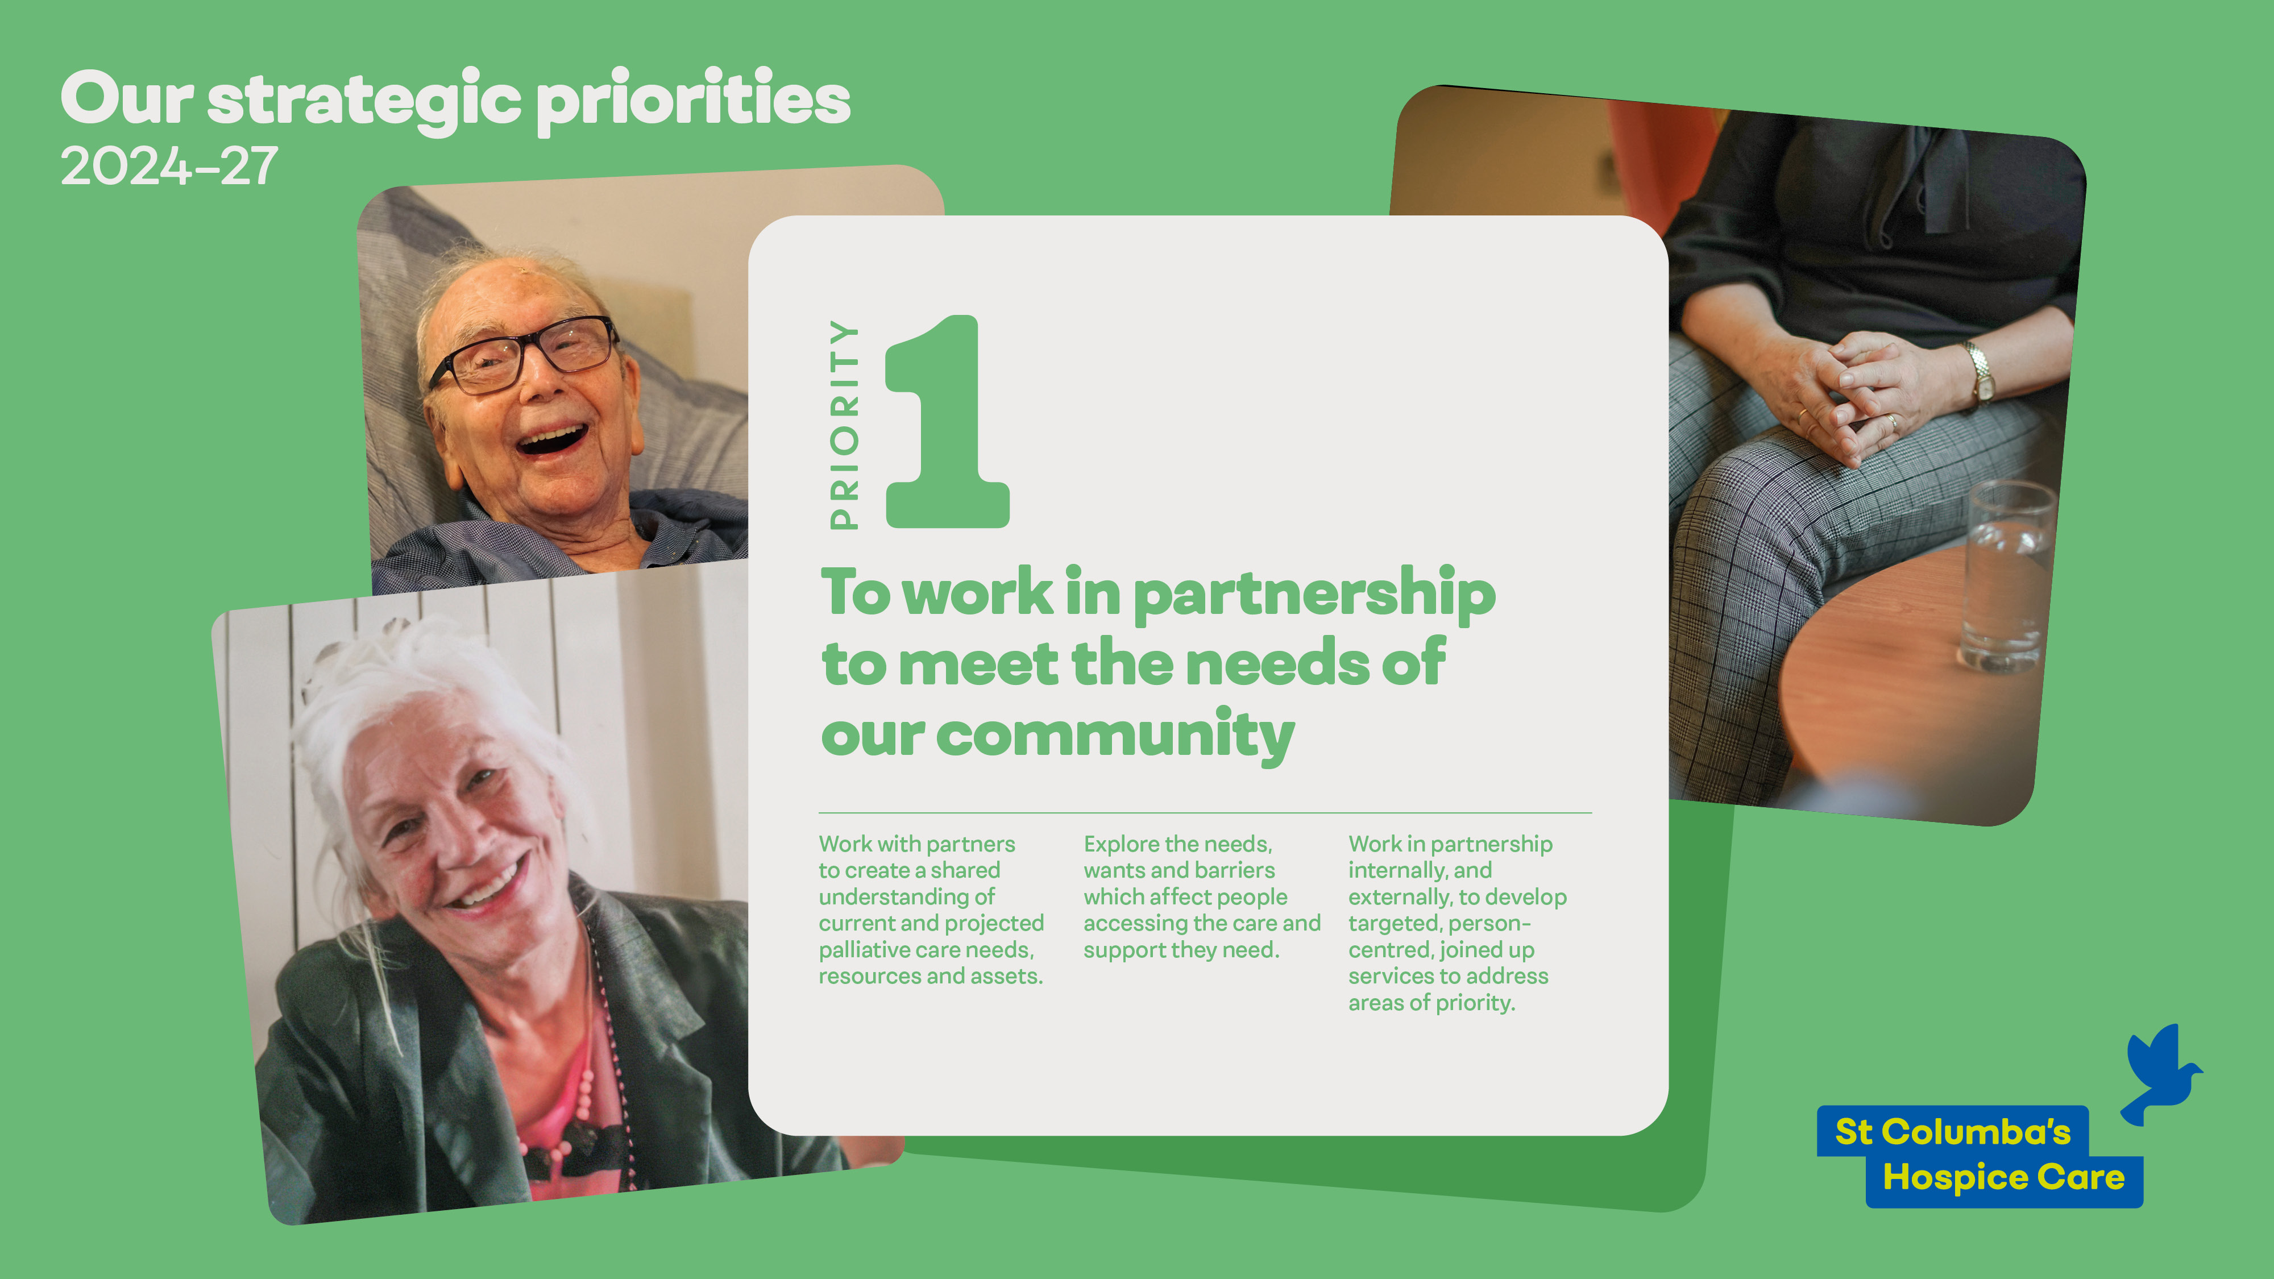

Slide 43
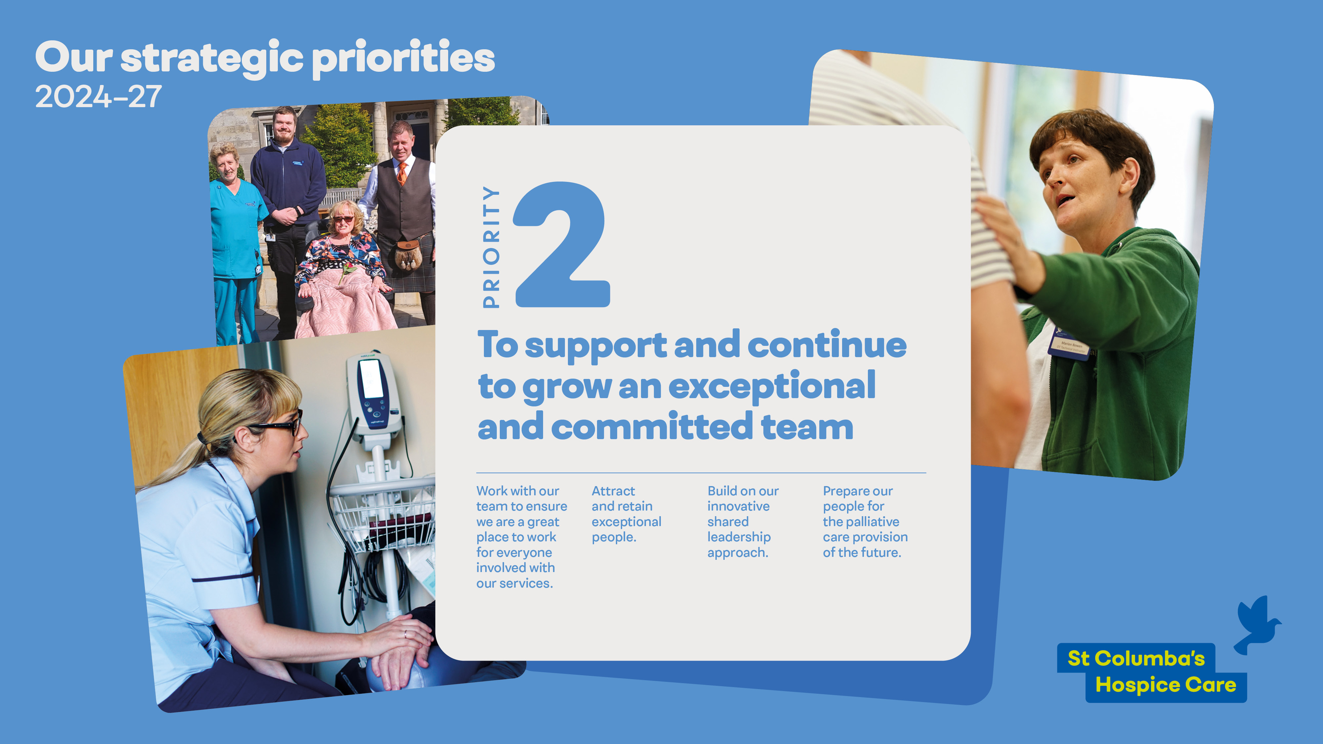

Slide 44
